Slide 1

WELCOME TO
Chhattisgarh
Board of Secondary Education, Raipur (C.G.)

Slide 2

Chhattisgarh Board of Secondary Education, Raipur
Higher Secondary Exam – 2025
Tentative Top 10

Slide 3
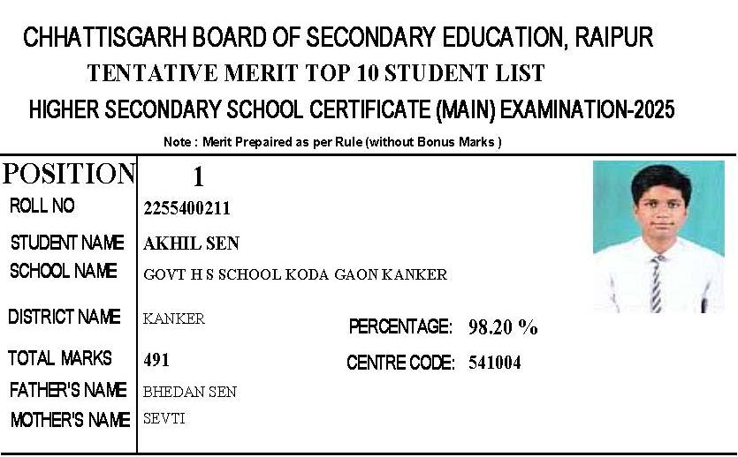

Slide 4
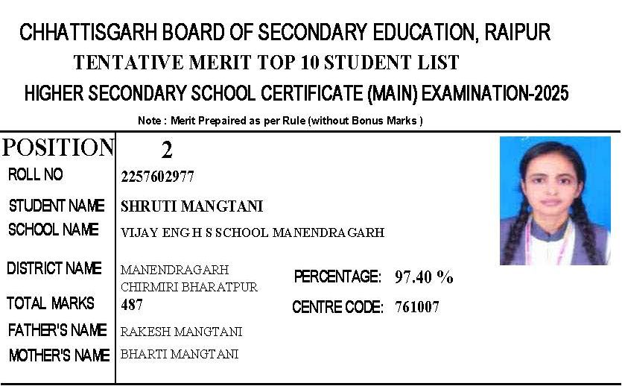

Slide 5
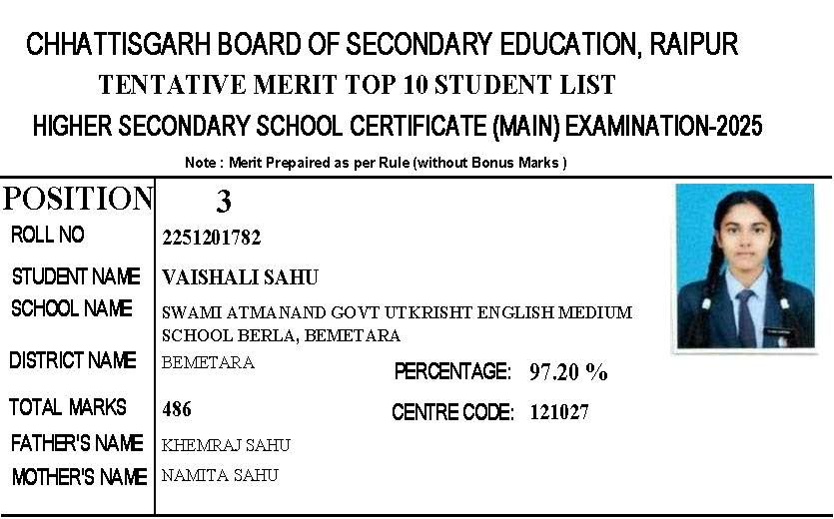

Slide 6
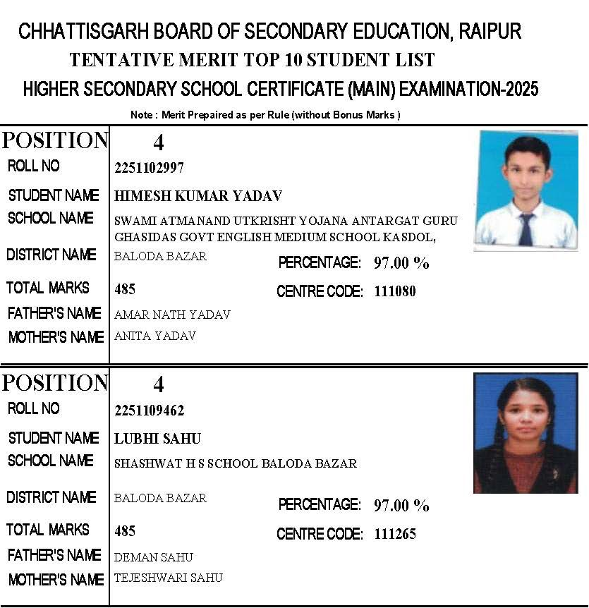

Slide 7
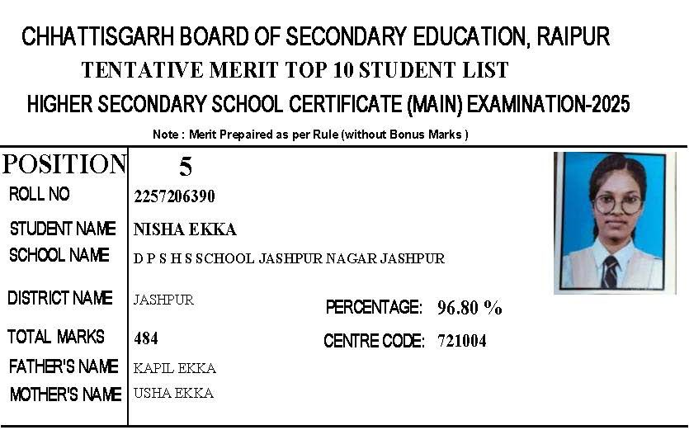

Slide 8
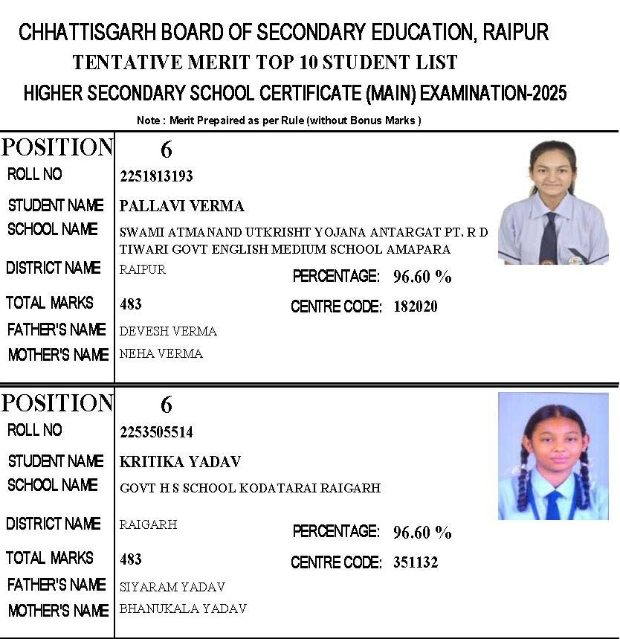

Slide 9
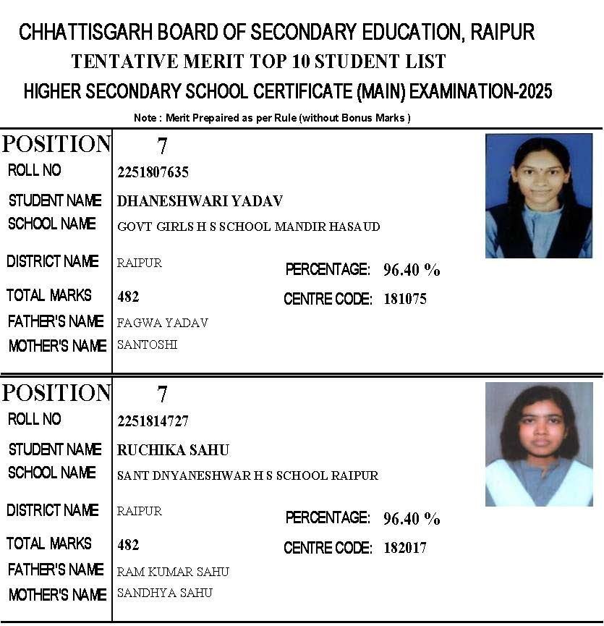

Slide 10
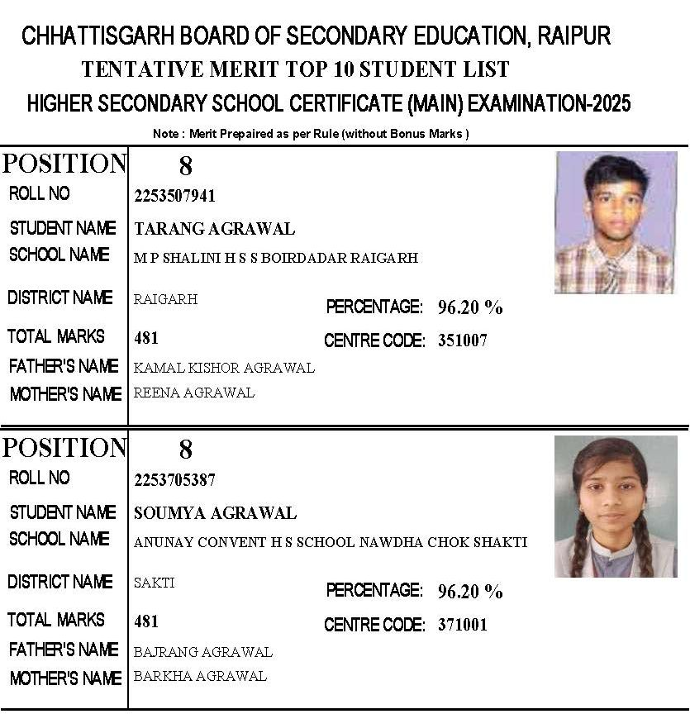

Slide 11
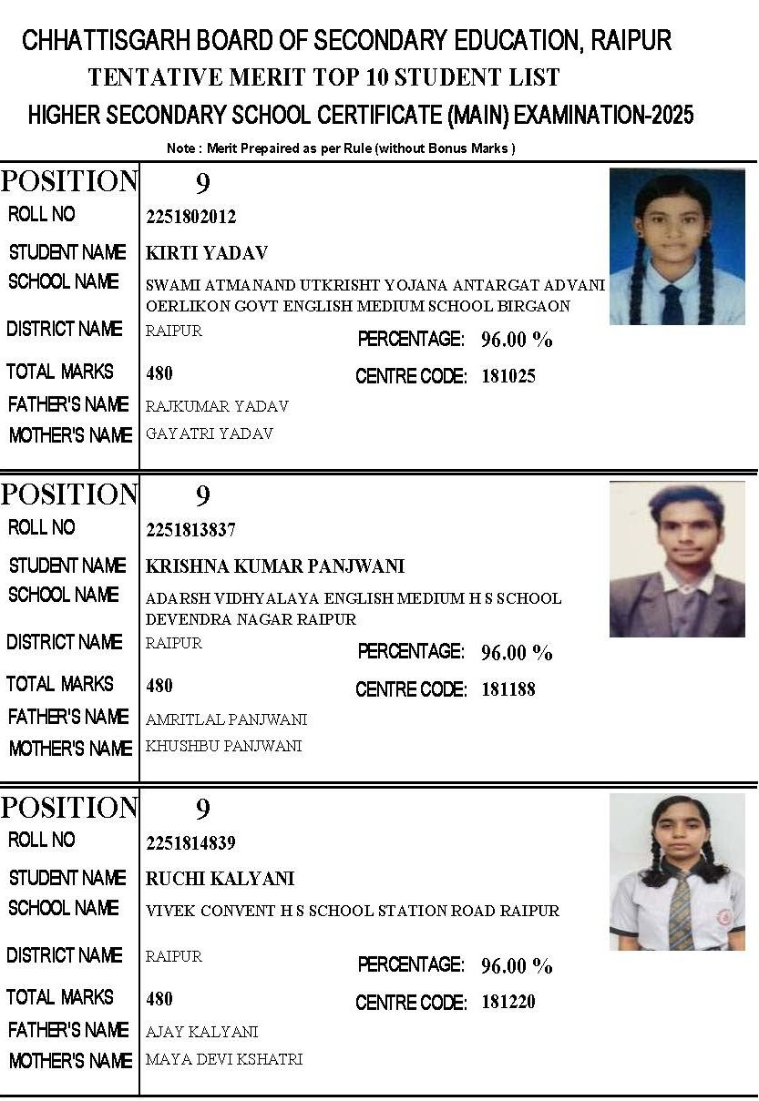

Slide 12
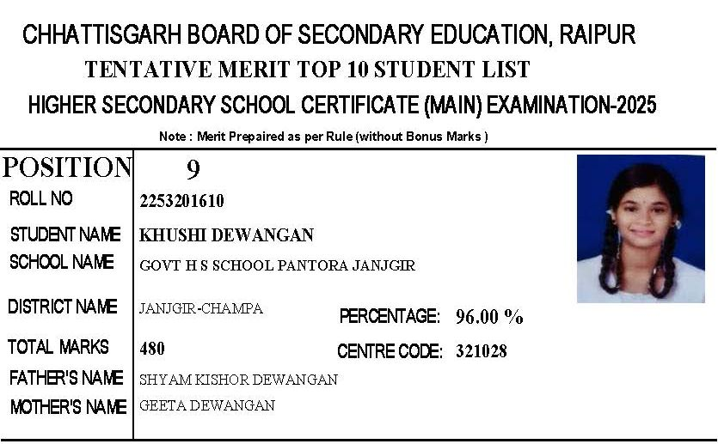

Slide 13
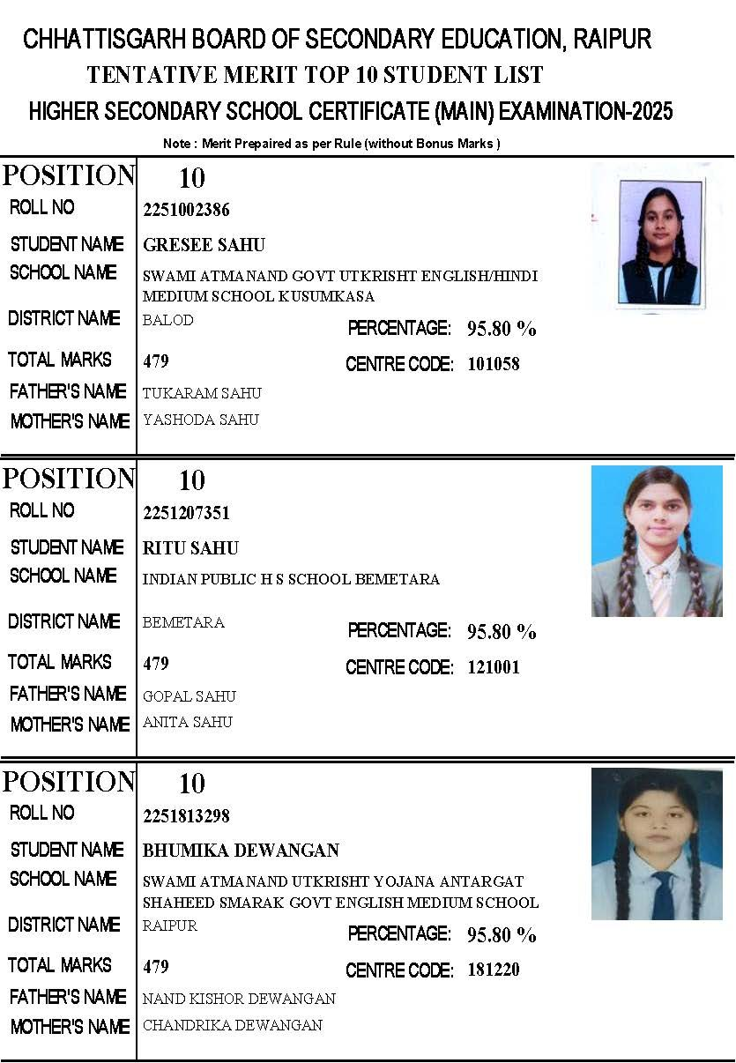

Slide 14
Thank You

